Slide 1
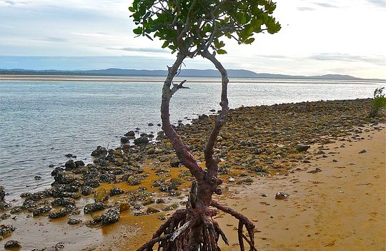
Scientific Paper Writing
Young Aspiring Female Environmental Scientists (YAFES)
By Dr Adenike-Adenaya

Slide 2
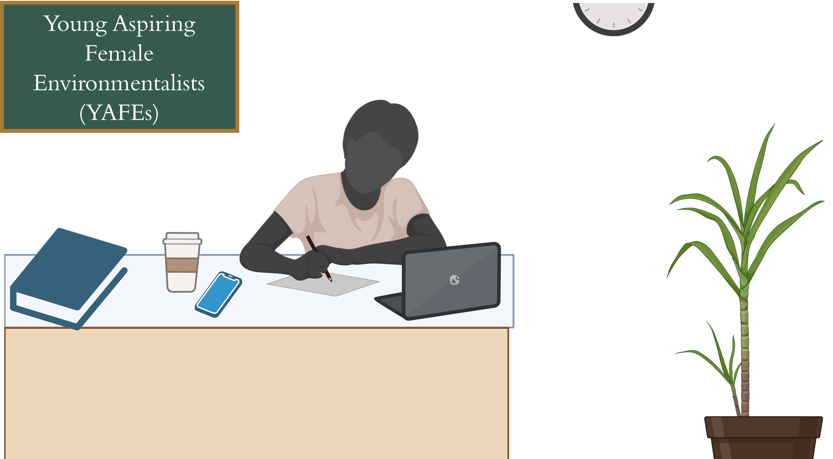
A little bit about YAFEs
Educate Masters students on how to write and publish scientific papers.
Target Group: Females
Major aim:
Publish at least one paper during their Masters (submitted within three months)
Enhance their academic profiles
Help them to become visible

Slide 3
A little bit about YAFEs
Why?
Because this is not within the undergraduate and graduate curricula
Because I struggled a lot when I started my Masters
Because females are scarce in the scientific worlds
Because it is very important for our voices to be heard

Slide 4

The end goal
3 Months
Collaboration: The submission of a review paper
Today
Notes:
Brief introduction with 1-2 images
Bullet points to lead along the red line

Slide 5
What you will learn today
Processes of peer-reviewed papers
How to select the journals for your paper
Tips on how to write good scientific papers
What are peer-reviewed papers
Importance of peer-reviewed papers (AKA scientific journals)

Slide 6
Importance of peer-reviewed journals (AKA scientific papers)
In academia, paper publishing plays a pivotal role as the major means of communication.
These papers, often referred to as academic currency, serve as an essential vehicle through which researchers can disseminate their findings to their peers.
By publishing papers, researchers not only make their work accessible for others to comprehend but also establish their visibility and credibility within the academic community.
To stand out and progress professionally in academic circles, the publication of papers is not just an option but an imperative requirement. Whether seeking employment in academia or aiming for a promotion, publishing papers remains an indispensable criterion for career development.
Publishing makes your works relevant, measures the quality of your work, and gives your work more leverage
Paper writing and publishing can be self-rewarding. When your paper is published, you can be proud of yourself

Slide 7
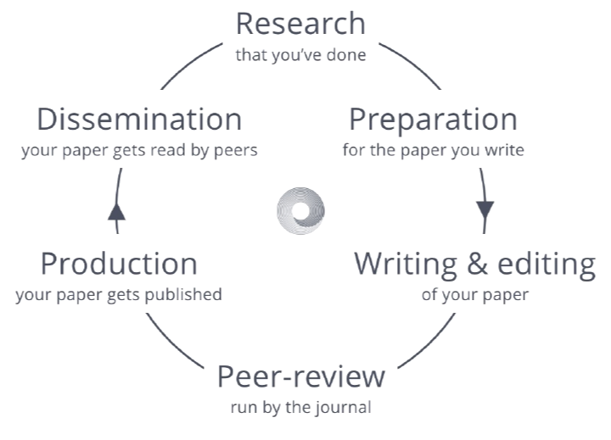
What are peer-reviewed papers and their processes
Primary data
Secondary data
Let us call it academic quality control that needs to be in place before any paper is submitted
You, as the Authors, write the paper, search for the journal, submit it to the journal, and wait for the quality control to take place
The process starts from the day that you submit your journal until the day that it is published
The review process could take 3 months, depending on the journal that you submit your work to
https://tressacademic.com

Slide 8
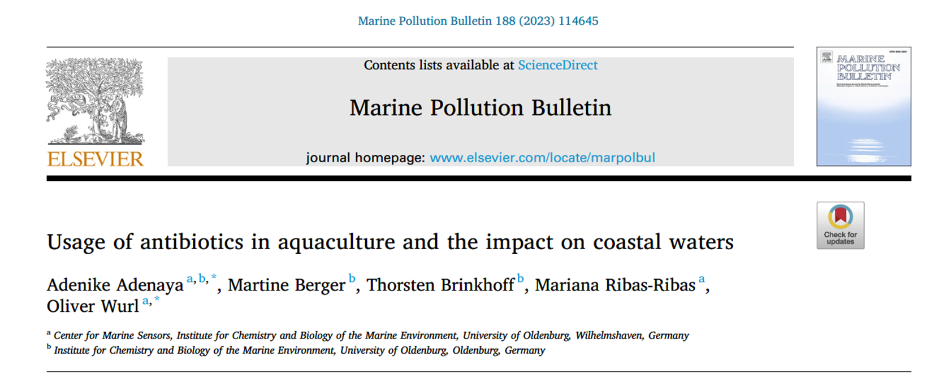
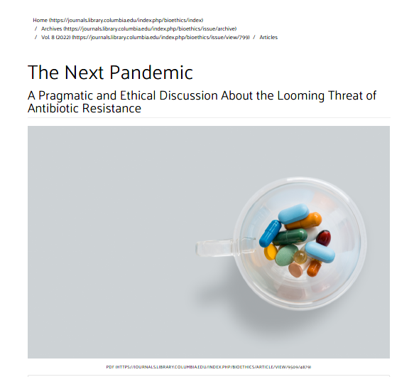
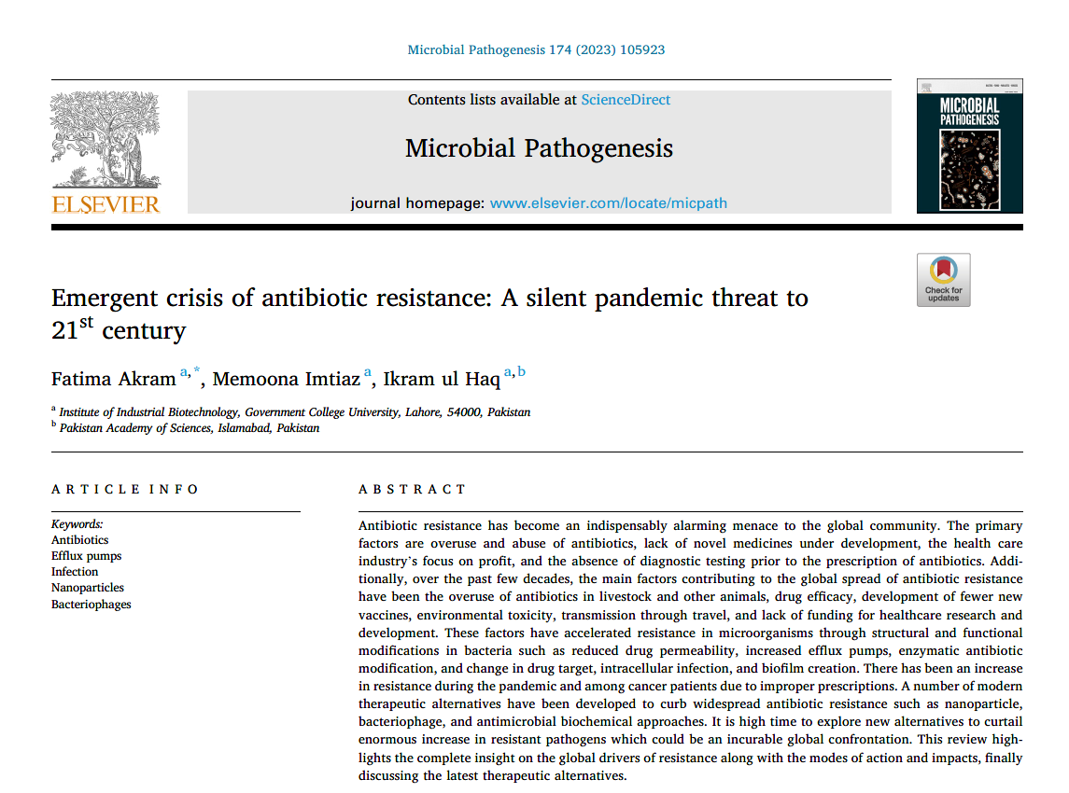
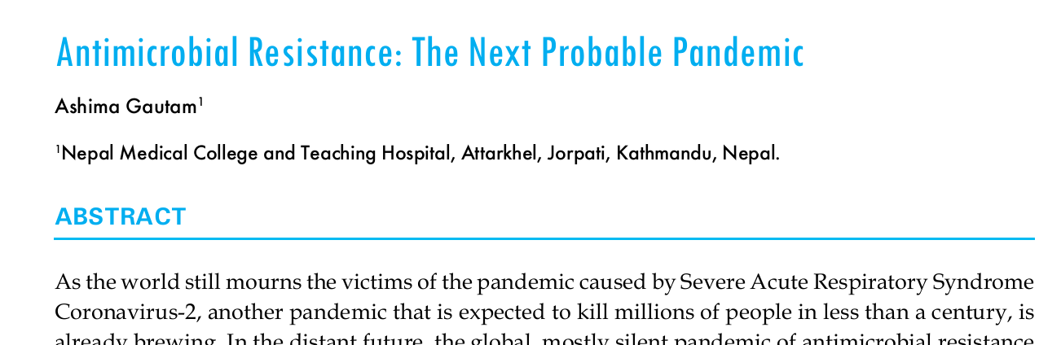
Antibiotic resistance could be the next pandemic

Slide 9
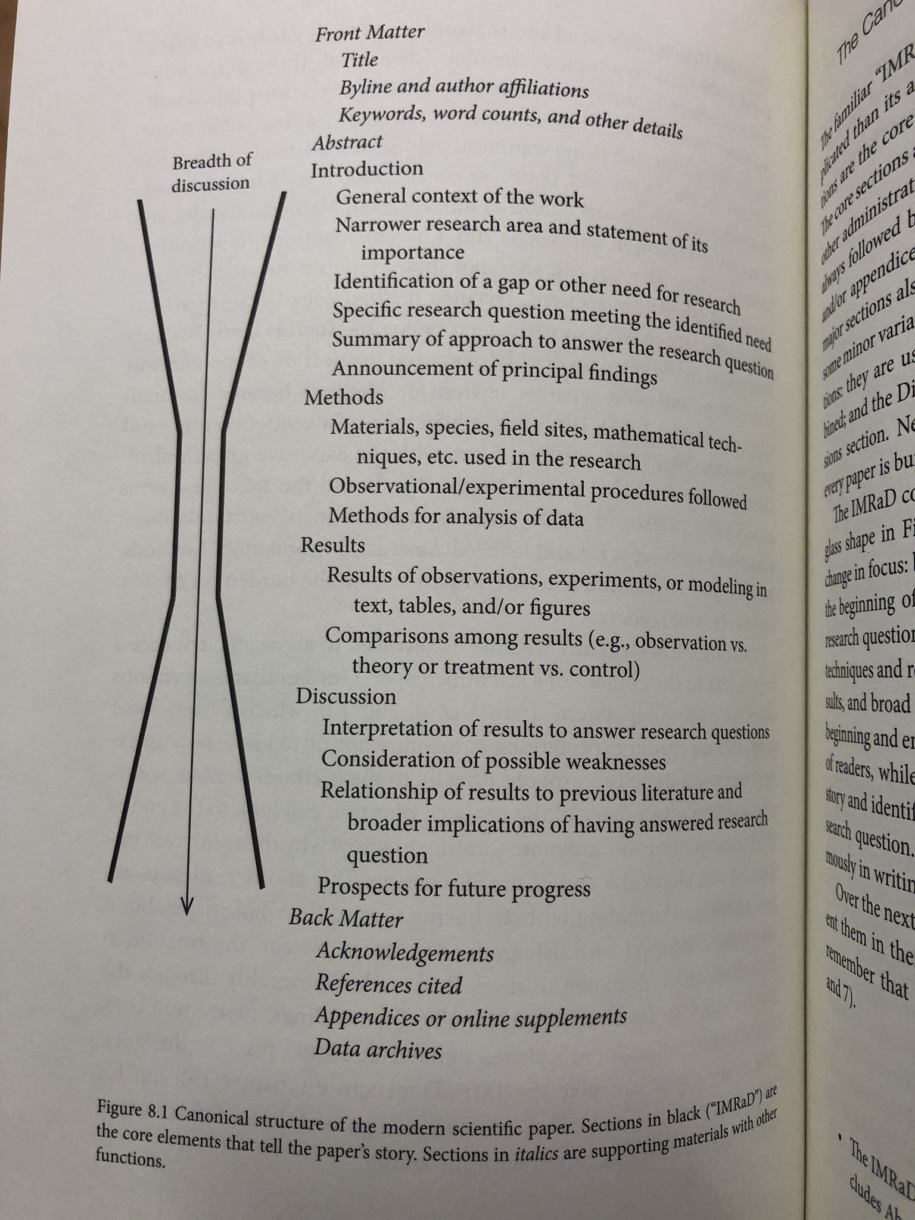
Structure Scientific Papers
IMRaD
Introduction,
Methods,
Results,
Discussion.
NB: This should be thought of as an hour-glass structure
Broad
Narrow
Broad
https://www.degruyter.com/document/doi/10.1515/9781400881147-009/pdf?

Slide 10
Structure Scientific Papers
Broad: The Introduction, literature review, the wide or global context, the overall problem
Narrow: The aim and objective part of the introduction states that we cannot solve all problems, but we are proposing one through which the problem can be solved, discussed, studied, what could cause the problem, and so on. This goes on to our methods and results.
Broad: Discussion and conclusion; the novelty of our work and the application of our result to broader or global contexts will help researchers
Broad
Narrow
Broad
https://www.degruyter.com/document/doi/10.1515/9781400881147-009/pdf?

Slide 11
Our Review Paper: Secondary research data. The use of database
Title | The most important sentence of any paper | It must be brief, informative, and interesting. It must contain keywords and an active verb. The type of the review must be stated in the title. Environmental factors contributing to the spread of antibiotic resistance in West Africa: a literature review
Introduction | Epidemiology (Broad Problem) | Comes in the first paragraph of your paper. All readers of that journal should be able to understand this paragraph. For Instance, a global health issue of antibiotic resistance, prevalence in Africa, especially sub-Saharan Africa, global epidemiology, African Epidemiology, and West Africa Epidemiology.
 | Environmental factors (Broad) | In the African context, for example, there is a lack of wastewater treatments, overuse in animal rearing, and discharge into the environment via animal wastes, a lack of regulations regarding antibiotic usage, self-medications leading to more discharge into the environment, and so on.
 | Our aim and objectives (Narrow pronlem) | Why is your study needed now? The narrow problem is the tension element, Which comes at the end of the Intro (First Act). It is the most essential and immediate likely impact of our study Environmental factors investigation only in West Africa Are there surveillance in place
Methods | Narrow | Sampling location: West Africa Sample justifications, Justification Data collection: A literature review using specific key works, Antibiotic resistance, Antibiotic-resistant bacteria and genes in West Africa, spread in the environments (soil, water, food), wastewater treatments and management (present or absent) Journal databases that can be used: Web of Science, PubMed, Google Scholar, Scopus, ScienceDirect, SpringerLink and so on. Data analysis: Prism and SPSS statistics depending on individual skills Ethical approval: no need
Results | Narrow | What we found out. Which antibiotic-resistant bacteria and what gene is widespread in which county in West Africa, Which environmental factor has the most in influence in which country in West Africa, Which surveillance exist in which country
Discussion | Broad | The application of our work in the global, Africa and West African context
Conclusion | Our work in the global context | The significance of our work in the global, African and West African Context

Slide 12
Journal selection
Rule of Thump: Check your reference section; which journal are you citing the most?
Use keywords related to your paper to explore specific journal databases that cover your research topics.
Very important: Your work must fit into the scope of the journal else, you risk your work being rejected, and you don’t want that.

Slide 13
Journal selection
Journal name | Journal scope | Impact factor | Website | Remark of our review paper (submission)
Environmental Pollution | Sources and occurrences of pollutants that are clearly defined and measured in environmental compartments, food and food-related items, and human bodies | 8.3 | https://www.sciencedirect.com/journal/environmental-pollution | No
Ecotoxicology and Environmental Safety | Epidemiological studies link environmental contamination to human health effects. | 6.2 | https://www.sciencedirect.com/journal/ecotoxicology-and-environmental-safety | No
Environmental Research | Environmental epidemiology | 7.7 | https://www.sciencedirect.com/journal/environmental-research | No
MDPI Bacteria | Bacterial ecology, Bacterial genomics and evolution. | - | https://www.mdpi.com/journal/bacteria | No
MDPI antibiotic | uses of antibiotics, including on animals and in agriculture antibiotic resistance and misuse | 4.3 | https://www.mdpi.com/journal/antibiotics | Yes

Slide 14
Writing problems and challenges:
Procastination
Perfectionism („Work smart, not hard“)
Fear of rejection & criticism
Writer‘s block/ Feeling stuck

Slide 15
Solution to writing problems: Project management
Planning; Planning is everything. Plans are nothing“ Don't start writing about your work before you know about the paper.
Start writing your paper early to avoid last-minute pressure.
Estimate how long each task will take you, but You don’t need to hit thousands of words per day–it is great if you manage to write just a little bit per day
Break your project into clearly defined tasks, eg, I will write one to two paragraphs today. Use short but regular writing sessions of 15, 30, or 45 minutes to build a writing routine.
Get the first draft of your paper with your ideas written. Apply this principle to any section or paragraph you're writing. It doesn’t have to be the best version of the paper, it’s just a draft.
Find your deep work time: When does the Idea flow? Schedule your writing sessions
Commit to your writing sessions (habit, cooperate with a friend). Adapt your plan as you go.
Dealing with Writer‘s block: Feeling stuck is common for writers at any level and suggests a need to rethink your approach to writing
Sometimes, it helps to take notes, brainstorm, and draft ideas for a paper in good, old-fashioned handwriting in a notebook.
Take a break

Slide 16
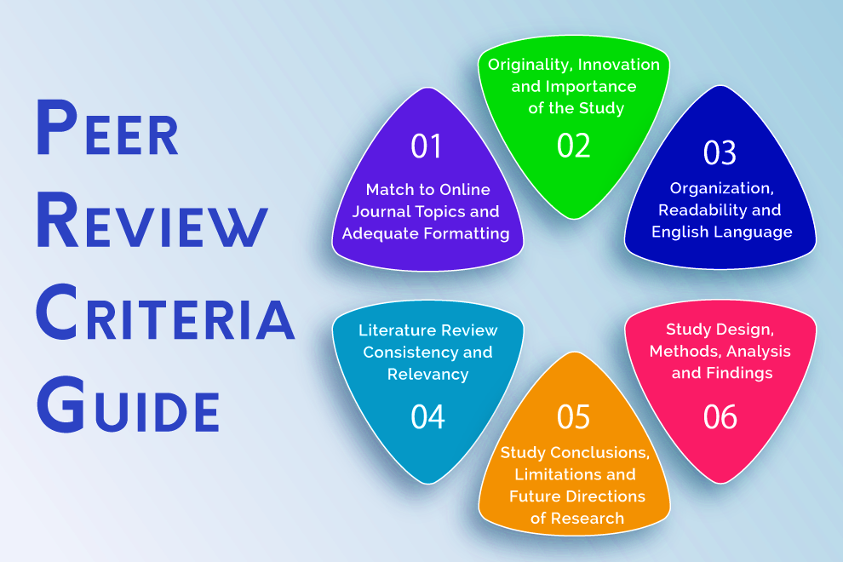
What are peer-reviewed papers
Page 16
25.10.2023
https://expertjournals.com/article-peer-review-guide/

Slide 17
Journal selection
Section | Responsible person
Introduction | Mariam and Kausara
Methods | Chidera and Adeyinka, Adenike
Results | Chidera, Adeyinka and Adenike
Discussion | Amarachi and Adenike
Conclusion | Amarachi and Adenike

